Slide 1



SQL
PROJECT
RESTAURANT OPERATIONS ANALYSIS

Slide 2
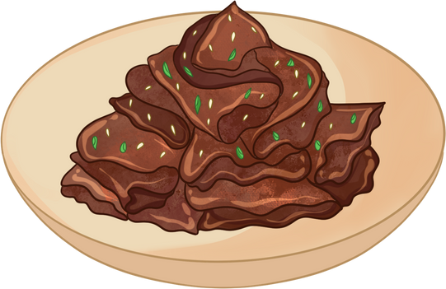

THE TASTE OF WORLD CAFE
Dishes Start
From 5$
ORDER NOW

Slide 3

THE ASSIGNMENT :
The Taste of the World Café debuted a new menu at the start of the year 2023.
We’ve been asked to analyze the customer data to see which dishes are doing well and not doing well.

Slide 4

THE OBJECTIVES:
1.Explore the menu_items table to get an idea of what’s on the menu.
2.Explore order_details table to get an idea of price range and date range.
3. Use both tables to understand how customers are reacting to the new menu.

Slide 5
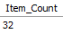
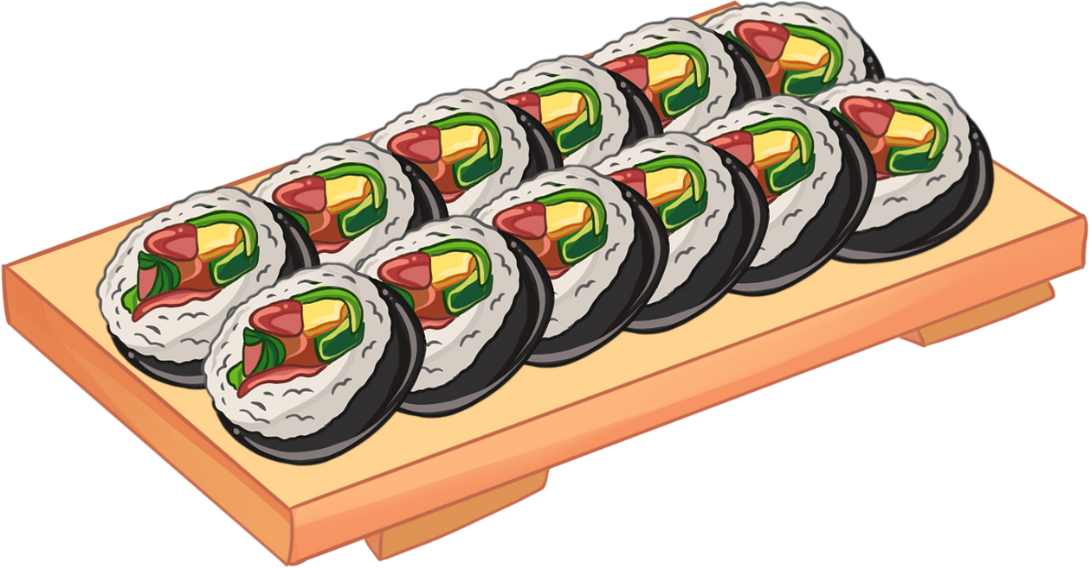
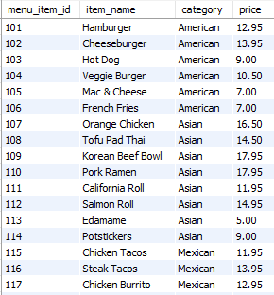
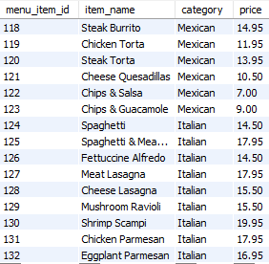
1.Exploring Menu_items table
2.Total number of items on the Menu
Query:
SELECT COUNT(*)
FROM MENU_ITEMS;
1.Exploring menu_item tables
Query:
Result:
SELECT *
from menu_items;
Result:

Slide 6
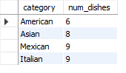
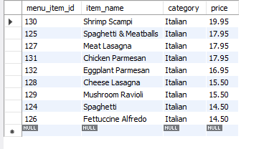
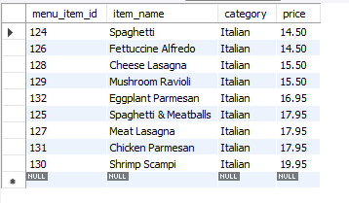

3.How many Items are
there in each category?
4.What are the Most expensive
items on the menu?
5.What are the Least expensive items on the Menu?
Query:
Query:
Query:
SELECT CATEGORY,COUNT(MENU_ITEM_ID) AS NUM_DISHES
FROM MENU_ITEMS
GROUP BY CATEGORY ;
SELECT *
FROM menu_items
where category = 'Italian’
order by price desc;
SELECT *
FROM menu_items
where category = 'Italian’
order by price;
Result:
Result:
Result:

Slide 7
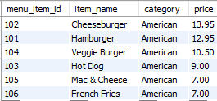
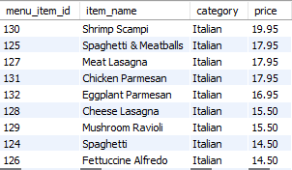

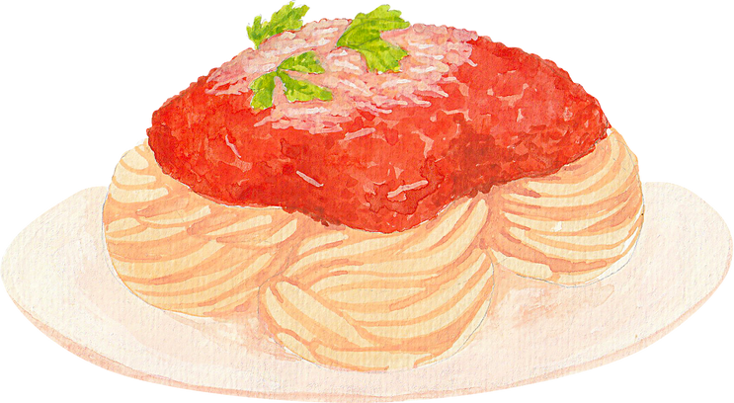
6.(a)What re the most and least expensive American items on the menu
6.(b) What are the most and
least expensive Italian items on the Menu?
Query:
Query:
Result:
Result:

Slide 8

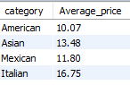
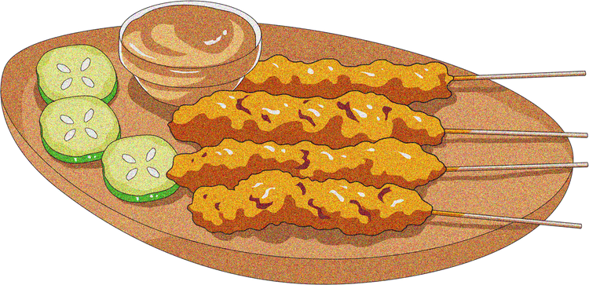
7.What is the average dish
price in each category?
Query:
Result:
SELECT CATEGORY,
ROUND(AVG(PRICE),2) AS AVERAGE_PRICE
FROM MENU_ITEMS
GROUP BY CATEGORY;

Slide 9
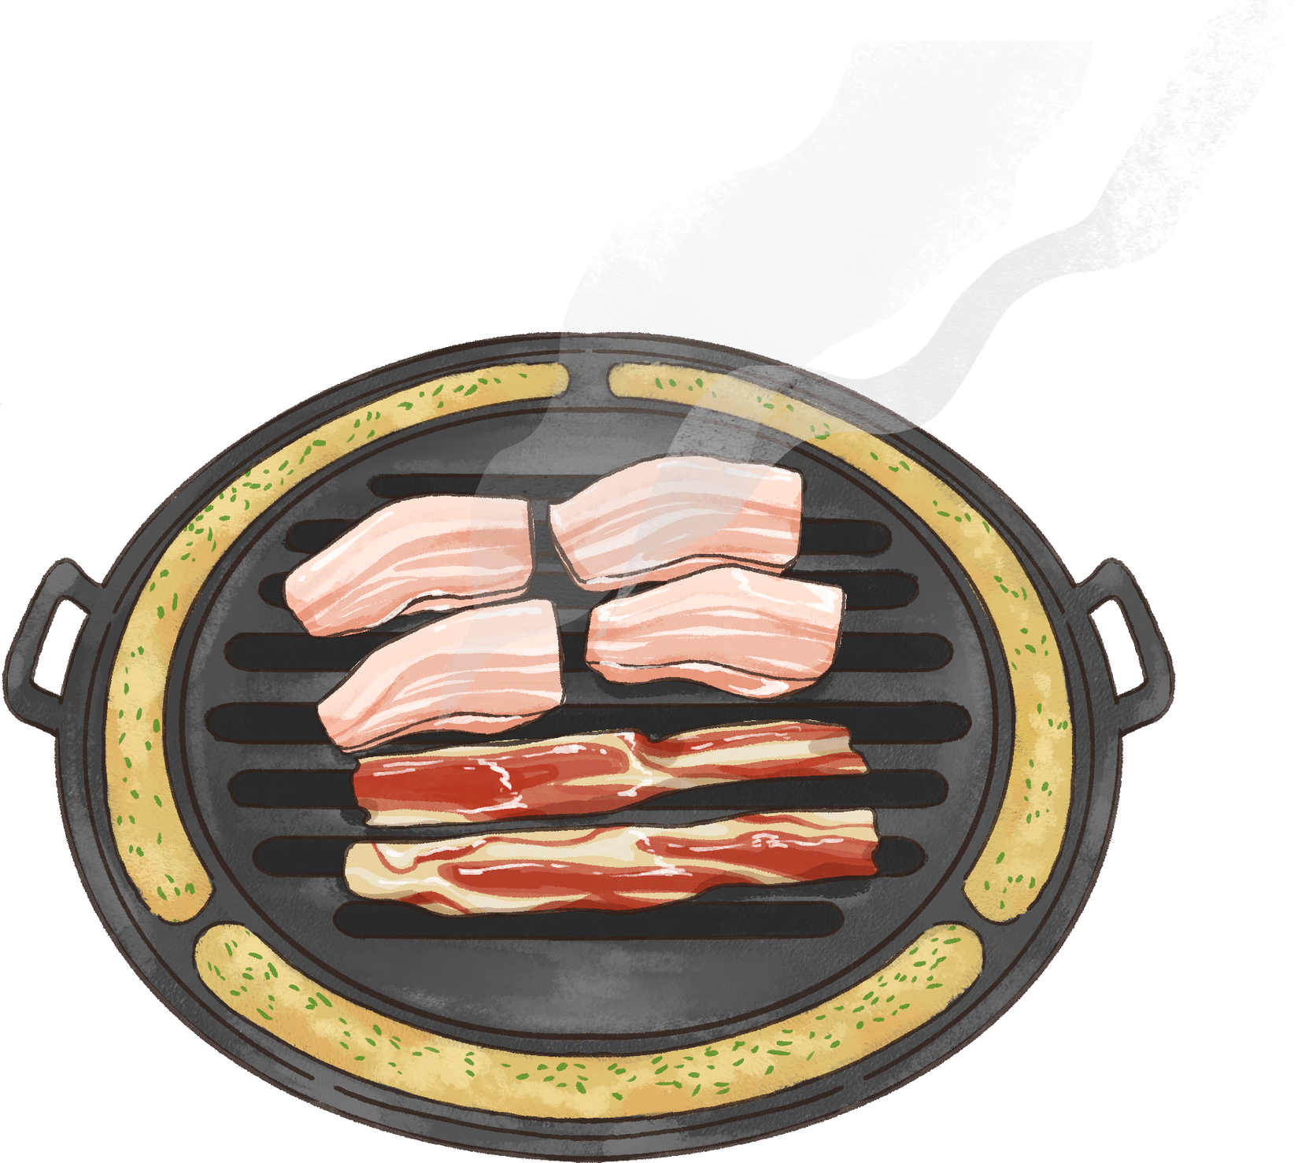
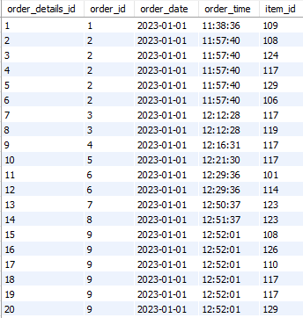
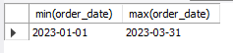
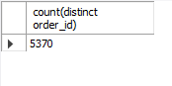
2.What is the date range of the table?
2.Exploring Order_details table
1.Explore order details table:
Query:
Query:
SELECT MIN(ORDER_DATE),MAX(ORDER_DATE) FROM ORDER_DETAILS;
SELECT * FROM ORDER_DETAILS;
Result:
Result:
3.How many orders were made during this date range?
Query:
SELECT COUNT(DISTINCT ORDER_ID) FROM ORDER_DETAILS;';
Result:

Slide 10
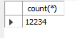
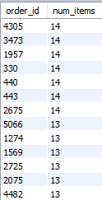
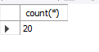

4.How Many items were ordered in the date range?
5.What is the maximum number
of items per order?
6.How many orders had more than 12 items?
Query:
Query:
Query:
SELECT ORDER_ID,
COUNT(ITEM_ID) AS NUM_ITEMS
FROM ORDER_DETAILS
GROUP BY ORDER_ID
ORDER BY NUM_ITEMS DESC;
SELECT COUNT(*) FROM
(SELECT ORDER_ID, COUNT(ITEM_ID)
AS NUM_ITEMS
FROM ORDER_DETAILS
GROUP BY ORDER_ID HAVING NUM_ITEMS > 12)
AS NUM_ORDERS ;
SELECT COUNT(*) FROM ORDER_DETAILS;
Result:
Result:
Result:

Slide 11
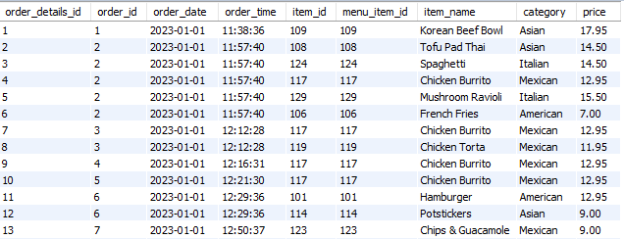
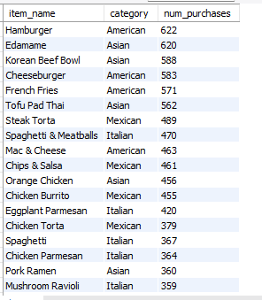
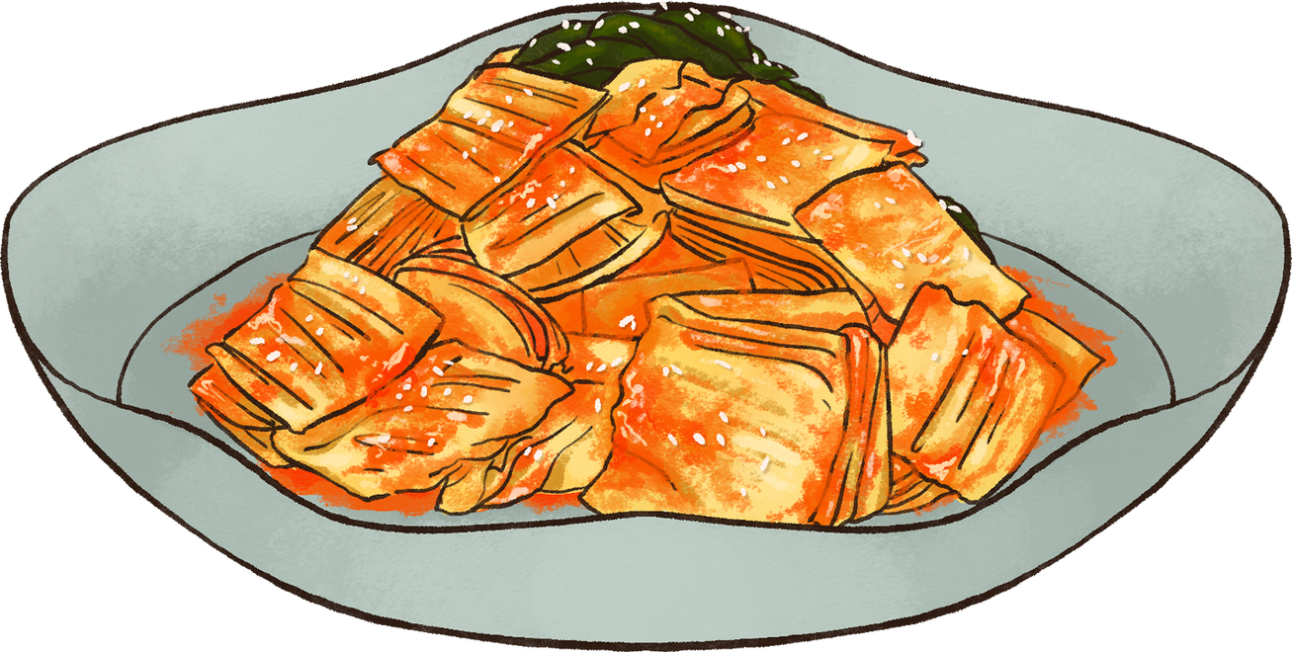
3.ANALYZING CUSTOMER BEHAVIOUR
1.Joining both the tables using Joins.
2.What were the most ordered items?
What categories were they in?
Query:
SELECT *FROM ORDER_DETAILS OD
LEFT JOIN MENU_ITEMS MI
ON OD.ITEM_ID = MI.MENU_ITEM_ID;
Query:
SELECT ITEM_NAME ,CATEGORY, COUNT(ORDER_DETAILS_ID) AS NUM_PURCHASES
FROM ORDER_DETAILS OD
LEFT JOIN MENU_ITEMS MI
ON OD.ITEM_ID = MI.MENU_ITEM_ID
GROUP BY ITEM_NAME, CATEGORY
ORDER BY NUM_PURCHASES DESC;
Result:
Result:

Slide 12
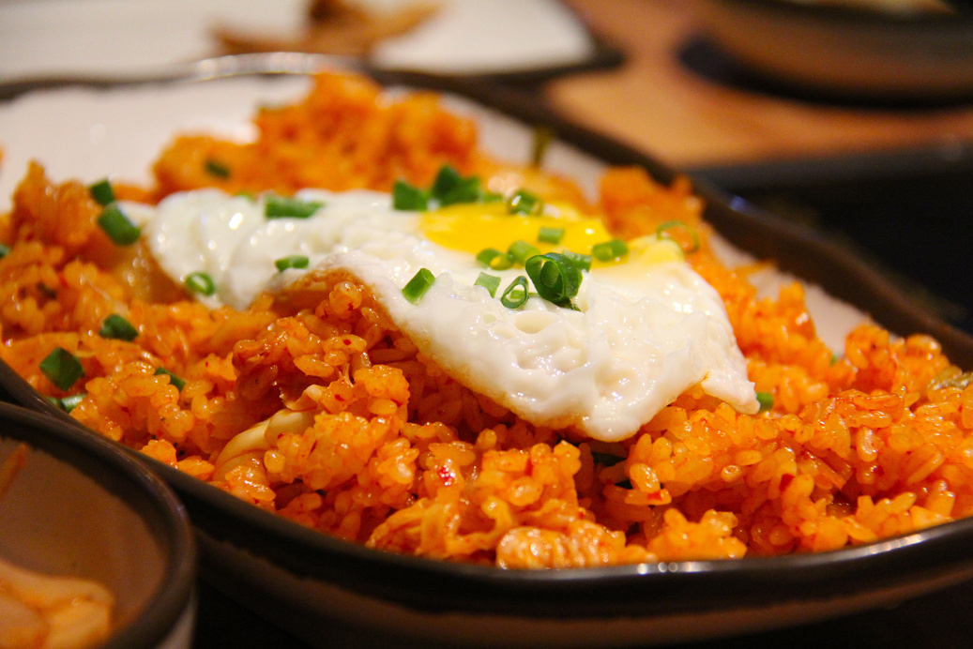
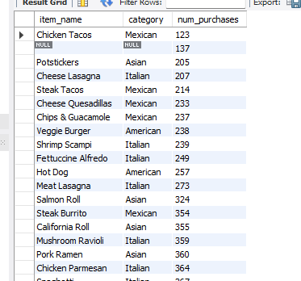
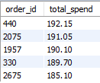
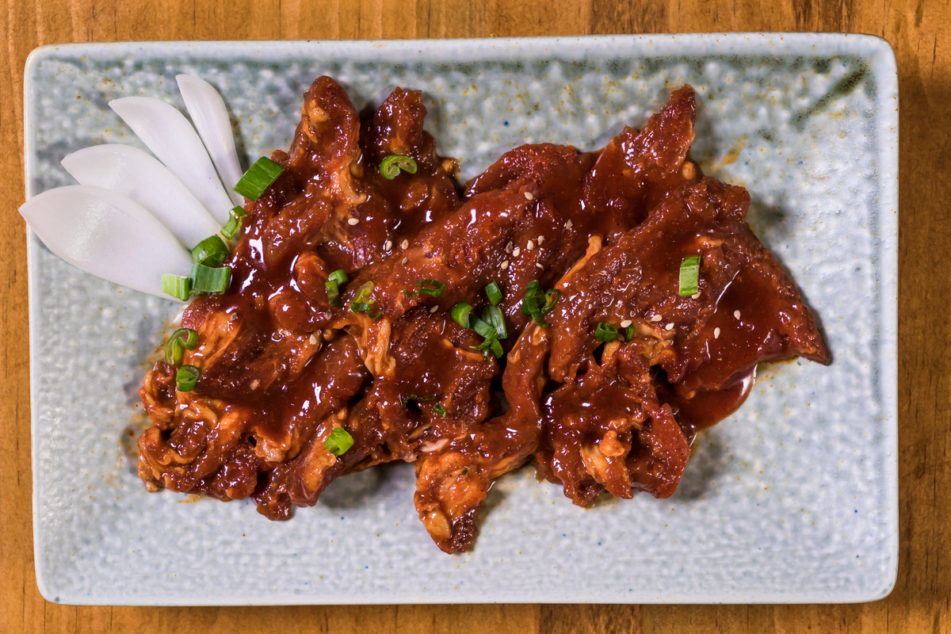
3.What were the least ordered items?
What categories were they in?
4.What were the top 5 orders that spent the most money?
Query:
Query:
SELECT ITEM_NAME ,CATEGORY, COUNT(ORDER_DETAILS_ID) AS NUM_PURCHASES
FROM ORDER_DETAILS OD
LEFT JOIN MENU_ITEMS MI
ON OD.ITEM_ID = MI.MENU_ITEM_ID
GROUP BY ITEM_NAME, CATEGORY
ORDER BY NUM_PURCHASES;
SELECT ORDER_ID,SUM(PRICE) AS TOTAL_SPENDFROM ORDER_DETAILS ODLEFT JOIN MENU_ITEMS MION OD.ITEM_ID = MI.MENU_ITEM_IDGROUP BY ORDER_IDORDER BY TOTAL_SPEND DESCLIMIT 5;
Result:
Result:

Slide 13
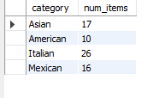
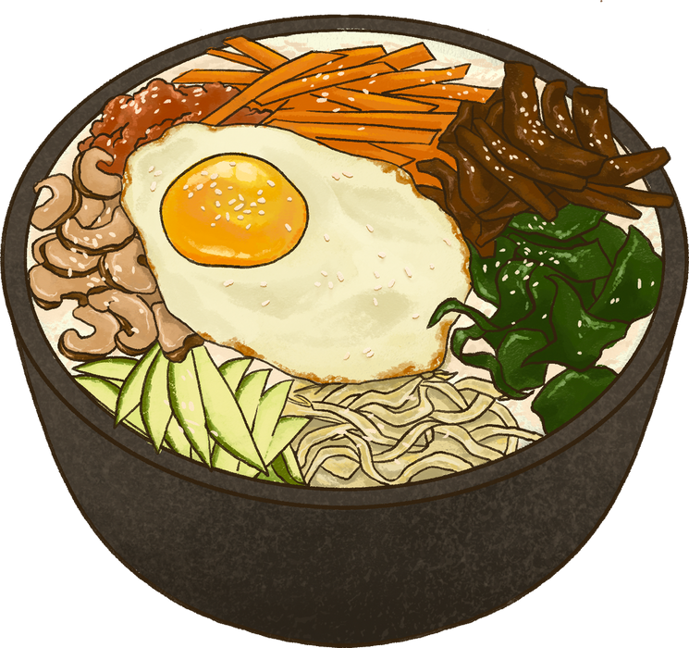
5. View the details of the top 5 highest spend orders. What insights can you gather from the results?
Query:
SELECT CATEGORY, COUNT(ITEM_ID) AS NUM_ITEMSFROM ORDER_DETAILS ODLEFT JOIN MENU_ITEMS MI
ON OD.ITEM_ID = MI.MENU_ITEM_ID
WHERE ORDER_ID
IN( 440,2075,1957,330,2675)GROUP BY CATEGORY ;
Result:

Slide 14
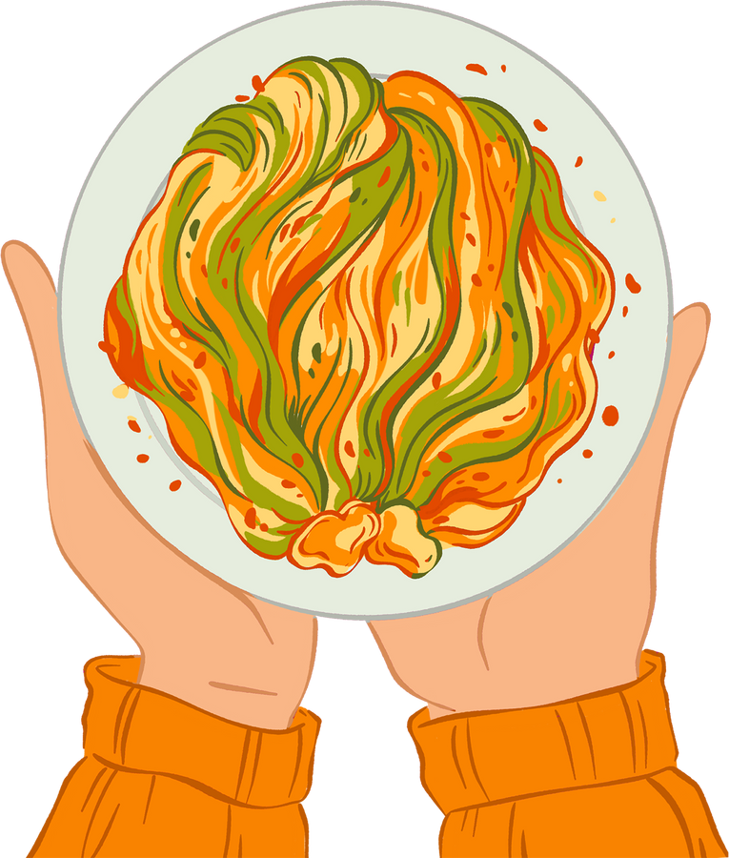
INSIGHTS
RECOMMENDATIONS
1. There are 32 new dishes on the menu
2. Count of dishes from different categories American 6 , Asian 8,
Italian 9, Mexican 9
3. Edamame from Asian is the least expensive ($5)
4. Shrimp Scampi from Italian is the most expensive ($19.95)
5. Italian dishes are the most expensive (Average price $16.75)
6. American dishes are most affordable (Average price $10.07)
7. Total Orders 5370, Number of items ordered 12234
8. Maximum Items per order is 14
9. Most ordered items are American (Hamburger (5.08%)) and Asian (Edamame (5.06%))
10. Highest spending order $192.15
11. 'Customers spent the most on the 'Korean Beef Bowl' from Asian category, 'Spaghetti & Meatballs' from Italian, 'Steak Torta' from Mexican, 'Cheeseburger' from Mexican.
12. Despite the higher prices of Italian dishes, customers still prefer to purchase them.
What Cuisines do our top spenders usually like to order from?
The Highest Spent Orders tend to spend a lot on Italian food.
We should keep these expensive Italian foods in our menu
because people seem to be ordering
them a lot ,especially our highest spend customers.

Slide 15
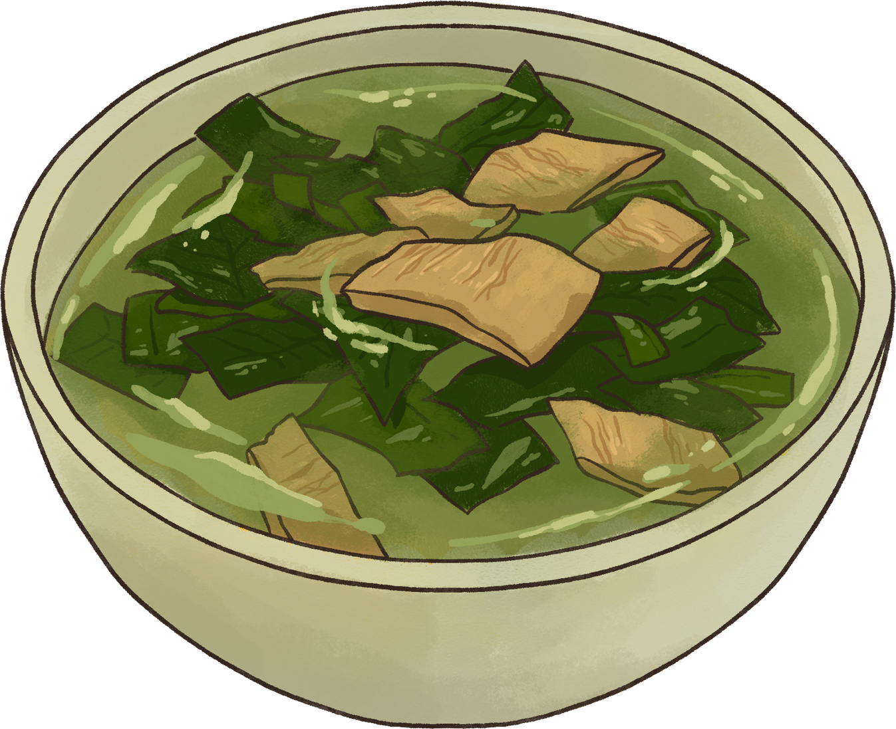


THANK YOU!
SQL Data Analysis
BY
SRI KANTH

